Slide 1
Data mining for Business Analytics
Naïve Bayes and Text Mining
ISOM3360
Lab 6

Slide 2
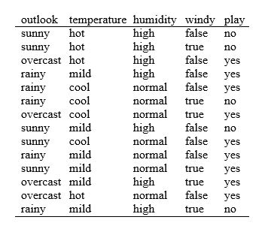
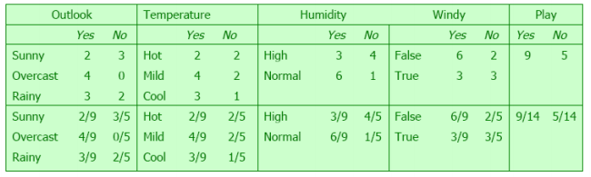

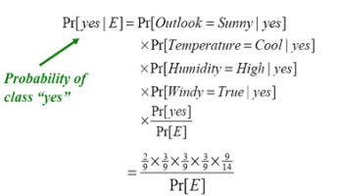
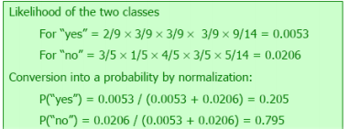
Naïve Bayes Learning – Review of the method (Weather/Golf Dataset)
We build the NB model based on counting
Once we have the NB model, we can use it event “play” based on different set of evidences. to predict the
We can ignore Pr(E) because we only need to “relatively” compare the value to other class. Therefore we have the following results:

Slide 3
Naïve Bayes
Naive Bayes methods are a set of supervised learning algorithms based on applying Bayes’ theorem with the “naive” assumption of conditional independence between every pair of features given the value of the class variable.
What kind of attributes we can use for NB model?
Naïve Bayes from Python sklearn https://scikit-learn.org/stable/modules/naive_bayes.html#multinomial-naive-bayes
Multinomial Naive Bayes https://scikit-learn.org/stable/modules/generated/sklearn.naive_bayes.MultinomialNB.html#sklearn.naive_bayes.MultinomialNB
The multinomial Naive Bayes classifier is suitable for classification with discrete features based on
Gaussian Naive Bayes
Dealing with continuous data occurrence counts.

Slide 4
Naïve Bayes – Multinomial NB – Data preparation
Weather / Golf example
Convert string labels (both attributes and target variable) into numbers
Import and create label encoder
Converting string labels into numbers
# Import LabelEncoder
from sklearn import preprocessing
#creating labelEncoder
le = preprocessing.LabelEncoder()
Note: scikit-learn implementation does not support categorical variables
data['Outlook_encoded'] = le.fit_transform(data['Outlook'])
data['Tem_encoded'] = le.fit_transform(data['Temperature'])
data['Humidity_encoded'] = le.fit_transform(data['Humidity'])
data['Windy_enoded'] = le.fit_transform(data['Windy'])
data['Label'] = le.fit_transform(data['Play'])

Slide 5
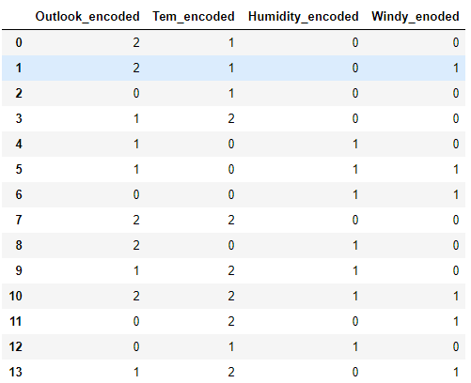
Naïve Bayes – Multinomial NB – modelling
Select features and set target variable
Create multinomial NB
alpha: Additive (Laplace/Lidstone) smoothing parameter (0 for no smoothing)
# define independent attributes
features = list(data.columns[5:9])
# assign values for independent variables and target variable (‘Label')
X = data [features]
y = data [‘Label']
#Import Multinomial Naive Bayes model from sklearn
from sklearn.naive_bayes import MultinomialNB
#Create a Multinomial Bayes Classifier
mnb = MultinomialNB()
class sklearn.naive_bayes.MultinomialNB(alpha=1.0, fit_prior=True, class_prior=None)

Slide 6
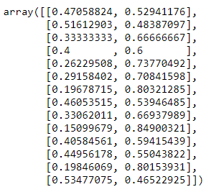
Naïve Bayes – Multinomial NB - evaluation
Cross validate result
Accuracy
Prediction labels
Prediction Probabilities
# import cross validation
from sklearn.model_selection import cross_val_score,cross_val_predict
score = cross_val_score(mnb,X,y,cv=3)
score.mean()
pred_y = cross_val_predict(mnb,X,y,cv=3)
pred_y
pred_proba = cross_val_predict(mnb, X,y,cv=3, method = 'predict_proba’)
pred_proba

Slide 7
Naïve Bayes – Multinomial NB – fit the model
Use the whole training set to fit the model
Use the model for prediction
Predict label
Predict Probabilities
# train model using training dataset
mnb.fit(X, y)
mnb.predict(testdata)
mnb.predict_Proba(testdata)

Slide 8
Example – Universal Bank
Predicting Personal Loan Acceptance Based on Naive Bayes Classifier
The file UniversalBank.csv contains data on 5000 customers of Universal Bank. The data include customer demographic information (age, income, etc.), the customer's relationship with the bank (mortgage, securities account, etc.), and the customer response to the last personal loan campaign (Personal Loan). Among these 5000 customers, only 480 (=9.6%) accepted the personal loan that was offered to them in the earlier campaign.
A brief description of the 14 variables are given below:
ID: Customer ID
Age: Customer's age in completed year
Experience: # years of professional experience
Income: Annual income of the customer (1,000)
ZIPcode: Home address ZIP code
Family: Family size of the customer
CCAvg: Average monthly credit card spending (1, 000)
Education: Education level: 1: undergrad; 2, Graduate; 3; Advance/Professional
Mortgage: Value of house mortgage if any (1, 000)
Personal loan: Did this customer accept the personal loan offered in he last campaign? 1, yes; 0, no
Securities Acct: Does the customer have a securities account with the bank?
CD Account: Does the customer have a certifcate of deposit (CD) account with the bank?
Online: Does the customer use internet bank facilities?
CreditCard: Does the customer use a credit card issued by the Bank?

Slide 9
Gaussian NB - Define features and target variable
Cross validate the linear model based on Mean Squared Error
# define independent attributes
features = ['Age', 'Income', 'Experience', 'Family', 'CCAvg', 'Education', 'Mortgage', 'Securities Account','CD Account', 'Online', 'CreditCard']
# assign values for independent variables and target variable ('Personal Loan')
X = data [features]
y = data ['Personal Loan']

Slide 10
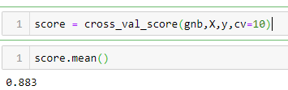
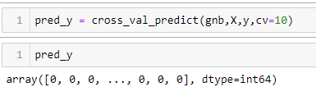
Naïve Bayes – Gaussian NB
Import Gaussian Naïve Bayes
Define Gaussian Naïve Bayes Classifier
Cross validate Gaussian Naïve Bayes Classifier
Prediction via from Cross validation
#Import Gaussian Naive Bayes model from sklearn
from sklearn.naive_bayes import GaussianNB
#Create a Gaussian Naive Bayes Classifier
gnb = GaussianNB()

Slide 11
Naïve Bayes – Gaussian NB
Fit a gnb classifier
Use the model for prediction
Predict label
Predict Probabilities
# train model using all training dataset gnb.fit(X, y)
gnb.predict(testdata)
gnb.predict_Proba(testdata)

Slide 12
Text Mining

Slide 13
Text Mining with Naïve Bayes
In the case of Spam detection
Document# | Class
Doc 1 | Ham
Doc 2 | Spam
Doc 3 | Spam
… | …
Doc n | Ham
Tokenization
Stemming
stop words
…
Document# 1 | Phrase 1 | Phrase 2 | Phrase 3 | Phrase 4 | … | Phrase j | Class
Doc 1 | 1 | 1 | 1 | 0 |  | 0 | Ham
Doc 2 | 0 | 1 | 0 | 1 |  | 2 | Spam
Doc 3 | 0 | 0 | 0 | 0 |  | 1 | Spam
… |  |  |  |  |  |  | …
Doc n | 1 | 1 | 0 | 3 |  | 0 | Ham

Slide 14
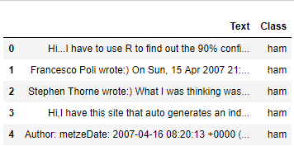
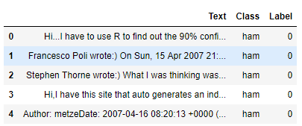
Data Set – Spam Email
725 email
Class: Ham or Spam
Load Dataset
Convert Label to numeric variable
Define features and target
# load dataset 'Spam.csv‘
dataset = pd.read_csv(‘SpamHamEmail.csv’)
# convert the 'label' column into a numeric variable; 'ham' as 0, 'spam' as 1
dataset['Label'] = dataset['Class'].map({'ham':0, 'spam':1})
# define X and y
X = dataset['Text']
y = dataset['Label']

Slide 15
Preprocessing
Import feature_extraction.text.CountVectorizer from sklearn
Build a vectorizer
# Import the CountVectorizer
from sklearn.feature_extraction.text import CountVectorizer
# instantiate the vectorizer
# https://scikit-learn.org/stable/modules/generated/sklearn.feature_extraction.text.CountVectorizer.html
vectorizer = CountVectorizer(encoding='utf-8',stop_words='english',min_df=0.02, max_df=0.5)

Slide 16
CountVectorizer
The CountVectorizer class
Parameters of CountVectorizer:
ngram_range : The lower and upper boundary of the range of n-values for different n-grams to be extracted. All values of n such that min_n <= n <= max_n will be used.
max_df : ignore terms that have a document frequency strictly higher than the given threshold (corpus-specific stop words). If float, the parameter represents a proportion of documents, integer absolute counts.
min_df : float in range [0.0, 1.0] or int, default=1 ignore terms that have a document frequency strictly lower than the given threshold.
max_features : only consider the top max_features ordered by term frequency across the corpus.
binary: If True, all non zero counts are set to 1
class sklearn.feature_extraction.text.CountVectorizer(input=’content’, encoding=’utf-8’, decode_error=’strict’, strip_accents=None, lowercase=True, preprocessor=None, tokenizer=None, stop_words=None, token_pattern=’(?u)\b\w\w+\b’, ngram_range=(1, 1), analyzer=’word’, max_df=1.0, min_df=1, max_features=None, vocabulary=None, binary=False, dtype=<class ‘numpy.int64’>)

Slide 17
Preprocessing
Learn the vocabulary dictionary and return term-document matrix
Get features / attributers / terms
Get the count of each terms in each document
# Learn the vocabulary dictionary and return term-document matrix.
X_vec = vectorizer.fit_transform(X)
# print the terms
print(vectorizer.get_feature_names())
# get the count of each terms in each document
print(X_vec.toarray())

Slide 18
Create a multinomial Naïve Bayes Classifier
Import cross validation
Import multinomial Naïve Bayes and create a Multinomial Naive Bayes Classifier
from sklearn.model_selection import cross_val_score,cross_val_predict
from sklearn.sklearn.naive_bayes import MultinomialNB
mnb = MultinomialNB()

Slide 19
Use cross validation to test multinomial Naïve Bayes model
Accuracy from cross validation
Classification report and Confusion matrix
score = cross_val_score(mnb,X_vec,y,cv=10)
score.mean()
# get predicted class for y
y_pred_class = cross_val_predict(mnb,X_vec,y,cv=10)
print("Confusion Matrix:", "\n", confusion_matrix(y, y_pred_class))
print("Classification Report:","\n", classification_report(y, y_pred_class))

Slide 20
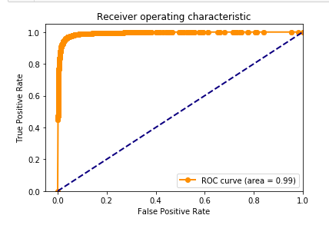
Use cross validation to test multinomial Naïve Bayes model
Import roc and auc
Get fpr, tpr and thresholds to construct ROC curve
AUC
from sklearn.metrics import roc_curve
from sklearn.metrics import auc
fpr, tpr, thresholds = roc_curve(y, y_pred_prob[:,1], pos_label=1)
# Area under ROC curve
roc_auc=auc(fpr,tpr)
roc_auc

